Slide 1


University of Basrah
College of Nursing
Management &Leadership in Nursing
Leadership
Lecture three
Prepared by :- assist lect. Noor salah shreaf

Slide 2
Leadership
leadership is the art of motivating a group of people to act towards
achieving a common goal.
leader is "a person who influences a group of people towards the
achievement of a goal".
A leader must be able to make people willingly want to accomplish
something. The leader's job is to get work done by other people.
Effective leadership means effective and productive group performance.

Slide 3
Need Of Nursing Leadership
High expectation of patient
New technology
Increased diversity in the workplace
Greater accountability for practice
A new spiritual focus on the mind and body connection
Increase in physical facilities and decrease in nursing personnel in the hospital.

Slide 4
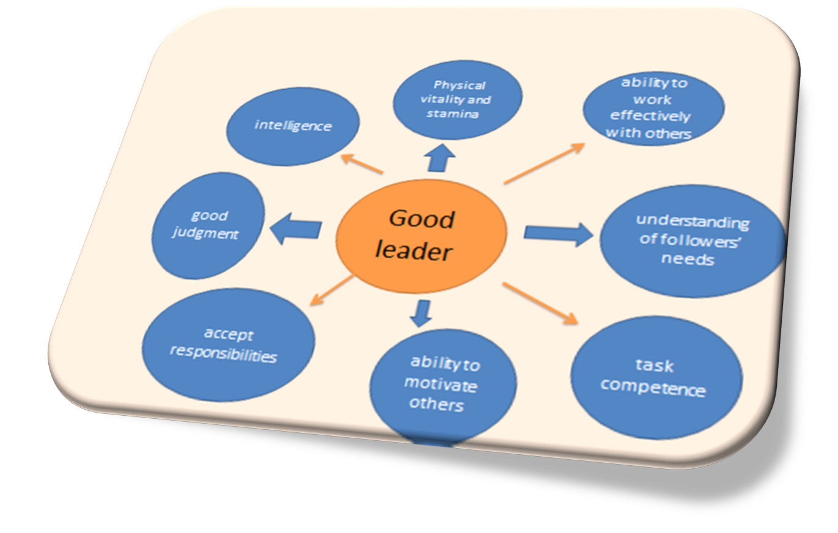

Slide 5
Leadership Style
A style is a particular form of behavior directly associated with
an individual. OR
The way in which a leader uses interpersonal influences to
achieve the objectives of the organization.
The style of leadership affect the health care delivery system . A style
allows nurses to interact more productively and more harmoniously to
achieve personal and organizational goals.

Slide 6
Leadership style
I: . Autocratic style of leadership - Authoritarian - Directive
Extreme form ''Dictators".
The leader assumes complete control over the decisions and
activities of the group. The authority for decision-making is not
delegated to persons in lower level positions. Centralized
organization.

Slide 7
The autocratic leader
1. Puts high concern for task accomplishment and low concern for
the people who perform those tasks.
2. Uses the efforts of workers (employees) to the best possible
advantage without regard to their interests.
3. Sets rigid standards and methods of performance and expects
followers (employees) to accept them, respect them and obey
directions

Slide 8
II: Democratic style of Leadership
This style is characterized by a sense of equality among leaders and
followers.
1. The leader is people oriented. Focuses attention on the human
aspect and builds effective work group, Togetherness is emphasized.
2. Works through people not by domination but by suggestions and
persuasions.

Slide 9
3. Performance standards exist to provide guidelines and permit
appraisal of workers. The result is high productivity.
4. Open system of communication prevails. The group participate
(share) in work-related decisions (problem-solving with the group).
The interaction between the leader and the group is open, friendly and
trusting.

Slide 10
The Democratic leader:
a. brings the subject to be discussed to the group.
b. consults with the group members and the decision of the majority is
made and is implemented by the total group.
c. makes the final decision after seeking input from the total group.
d. Motivates workers to set their own goals, makes their own work plans
and evaluates their own performance.
e. Informs employees of the overall purpose and progress of the
organization.

Slide 11
III: Laissez-faire style of leadership:-
The leader gives up all power to the group. This encourages
independent activity by the group members. An outsider would not be
able to identify the leader in such a group.
1. The leader (who may or may not be present) exerts little or no
influence on the group members. Lack of central direction , supervision, coordination and control.
2. Group members (workers - employees) are free to set their own goals and determine their own activities and are allowed to do almost
whatever they desire.

Slide 12
3. This style may be chosen by the leader or it may evolve because the
leader is too weak to exert any influence on the group.
4. This style is not useful in the highly structured health care delivery
system where organizations and control form the baseline of most
operations.

Slide 13
IV: bureaucratic style. In this style , the leader functions only on
lines with rules and regulations. The leader is inflexible and does not
like to take any risks.

Slide 14
Comparisons of Leadership Styles
Autocratic | Democratic | Laissez faire | bureaucratic
Strong | Less | Little or none | Control over group
By concern | Economic / ego a ward | by support | Motivation
By command | Suggestion by guidance | Little, upward& downward | Direction
Self | Participative | Dispersed | Decision making
I & you | We | The group | Emphasis( status differences)
Punitive | Constructive | None | Criticism

Slide 15
Factors that used to adopt the Leadership Style
1. The nature of the work ( lCU, regular unit).
2. The characteristics of nursing staff (knowledge, competencies,
attitudes, expectations, etc.).
3. The time available.
4. The importance of the results (output - enhanced quality care).

Slide 16
The qualities of Leader
A: Managerial abilities:
B: Interpersonal Relationship
C: Temperament (Nature or Disposition or character)
D: Credibility and Forward thinking
E: Professionalism
F: Advocate

Slide 17
Manager and Leader
Managers | Leaders
Administrators | Innovators
Relies on control | Inspires trust
Short term plans | Long term plans
Eye on bottom line | Eye on the horizon
Does things right | Does the right thing

Slide 18


Slide 19
REFERENCES
Koontz H &Weihrich H . Essentials of management an international
perspective. (Istedn). New Delhi: Tata McGraw Hill publishers; 2007.
Koontz H &Weihrich H. Management a global perspective. 1st edn. New Delhi: Tata Mc. Graw Hill publishers;2001.
Anthony M K, Theresa S, JoAnn Glick, Martha Duffy and Fran Paschall. Leadership and nurse retention, the pivotal role of nurse managers. JONA. Vol 35, Mar 2005

Slide 20
Home work
1- define leadership and leader?
2-different between leader and manager?
3- Factors that used to adopt the Leadership Style?

Slide 21


